Slide 1
Software Product Requirements

Slide 2
Definition
A requirement is a property or behavior that something must exhibit—it is something demanded or necessary.
A Specification is a precise description of something.
A requirements specification is a precise description of properties or behaviors that something must have.

Slide 3
Required According to Whom?
A product stakeholder, or just a stakeholder for short, is anyone affected by a product or its development.
Customers
Users
Clients
Developers
Regulators
Marketers

Slide 4
Required According to Whom? (cont.)
Stakeholders have a say in the requirements for a product, but they can’t have the final word. Why?
Conflicting desires and ideas;
Incomplete and incorrect;
Too abstract.
Hence, we need to distinguish between stakeholder needs and requirements.
Stakeholder needs are features or properties that particular stakeholders desire in a product
Requirements are product features or properties agreed by all.

Slide 5
Functional vs. Non-Functional
Functional needs and requirements are about how a software product must map inputs to outputs.
Non-functional needs and requirements are about properties that a software product must have.

Slide 6
Levels of Abstraction in Specifications
Software engineers have terms for specifications at various levels of abstraction.
Business requirement specifications
User-level needs and requirements
Operational-level needs and requirements
Physical-level needs and requirements.

Slide 7
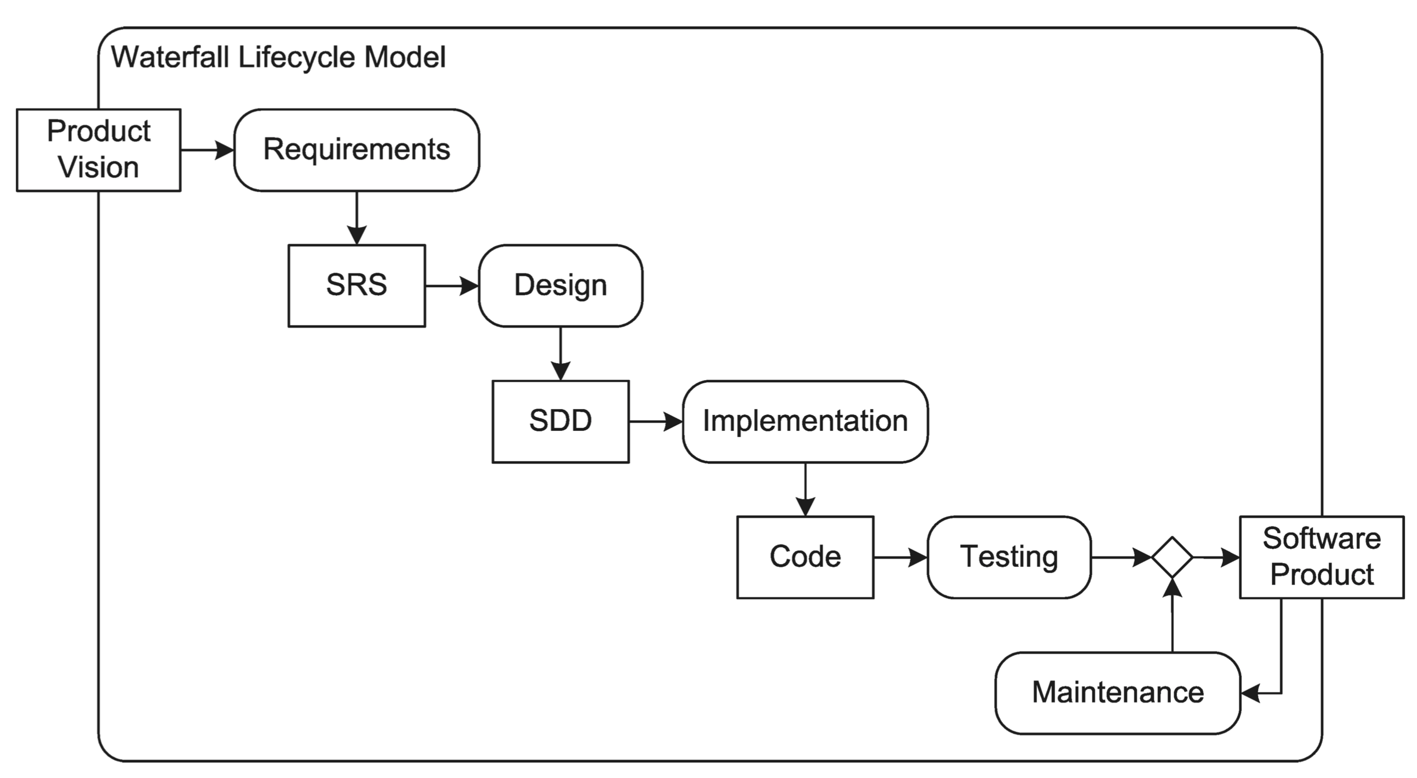
Requirements in Traditional Processes
In the waterfall model, all the requirements for the product (or as near as possible) are determined before almost anything else is done.

Slide 8
Requirements in Traditional Processes (cont.)
In the waterfall model, all the requirements for the product (or as near as possible) are determined before almost anything else is done.
This has often not worked well.
It is very difficult (perhaps impossible) to determine all requirements for non-trivial products before any implementation is done.
Stakeholder needs and desires changes over time.
Documenting all the requirements is difficult.
The whole process takes too long.

Slide 9
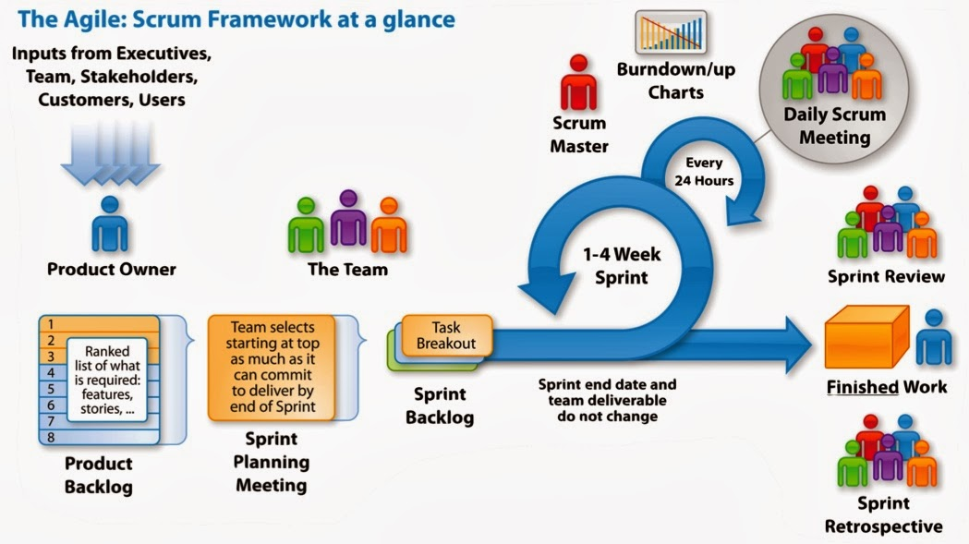
Requirements in Agile Processes
Inputs from Stakeholders

Slide 10
Requirements in Agile Processes (cont.)
Scrum can make requirements specification and change as easy and cheap as possible, by
Delay choosing requirements as long as possible
Delay refinement as long as possible
Avoid writing requirements altogether
Determine requirements in light of current product features
Notes:
Section 1 09132018

Slide 11
Stating Specifications in Traditional Processes
Most specifications are stated in English (or other natural languages).
English specifications may be vague or ambiguous, and still hard to understand.

Slide 12
Stating Specifications in Traditional Processes
Rules to specification writing:
Write complete, simple sentences in the active voice.
Define terms clearly and use them consistently.
Use the same words for the same thing—avoid synonyms.
Group related material into sections.
Use tables, lists, indentation, white space, and other formatting aids to present and organize material clearly and concisely.
Expressing all specifications using the words “must” or “shall.”
Specifications should be testable or verifiable.
Specifications should be easy to understand and to change.
Each specification should state only a single need or requirement – Atomic.
Each one should have a unique identifier.
Notes:
Section 5

Slide 13
Stating Specifications in Traditional Processes
Recording Requirements as Structured Text
Nonfunctional Requirements by Type
1. The product must be accessible as a WWW page.
1.1. The main file for the product must be written in HTML. (S1, S2, S3, S4, S5, S6, S7, S8, S9)
1.2. The form/presentation of the user interface must be written in CSS.
1.3. The algorithms required by the product must be written in Javascript.
Functional Requirements by Type
1. Startup Requirements
1.1. Startup Study Guide Requirements
1.1.1. The product must be able to start with out a study guide.
1.1.2. The product must be able to open a particular study guide at startup. (U3)
1.1.2.1. It must be possible to identify the guide in the URL of the main file.
1.2 It must be possible to include start-up option the URL of the main file.
1.2.1. It must be possible to specify the default server as a start-up option.
1.2.2. It must be possible to specify the directory as a start-up option.

Slide 14
Stating Specifications in Traditional Processes
Recording Requirements as Use Cases
What is a use case?
An abstract episode or interaction between a system and its environment
A description of one or more sequences of actions that a system performs to yield an observable result
A dialog that a system and its environment share as they interact
A way of using a system

Slide 15
Use Cases (cont.)
Properties of Good Use Cases
A use case should be an entire transaction
A withdrawal from an ATM machine
A telephone call
The collection of uses cases should entirely characterize the functionality of the system

Slide 16
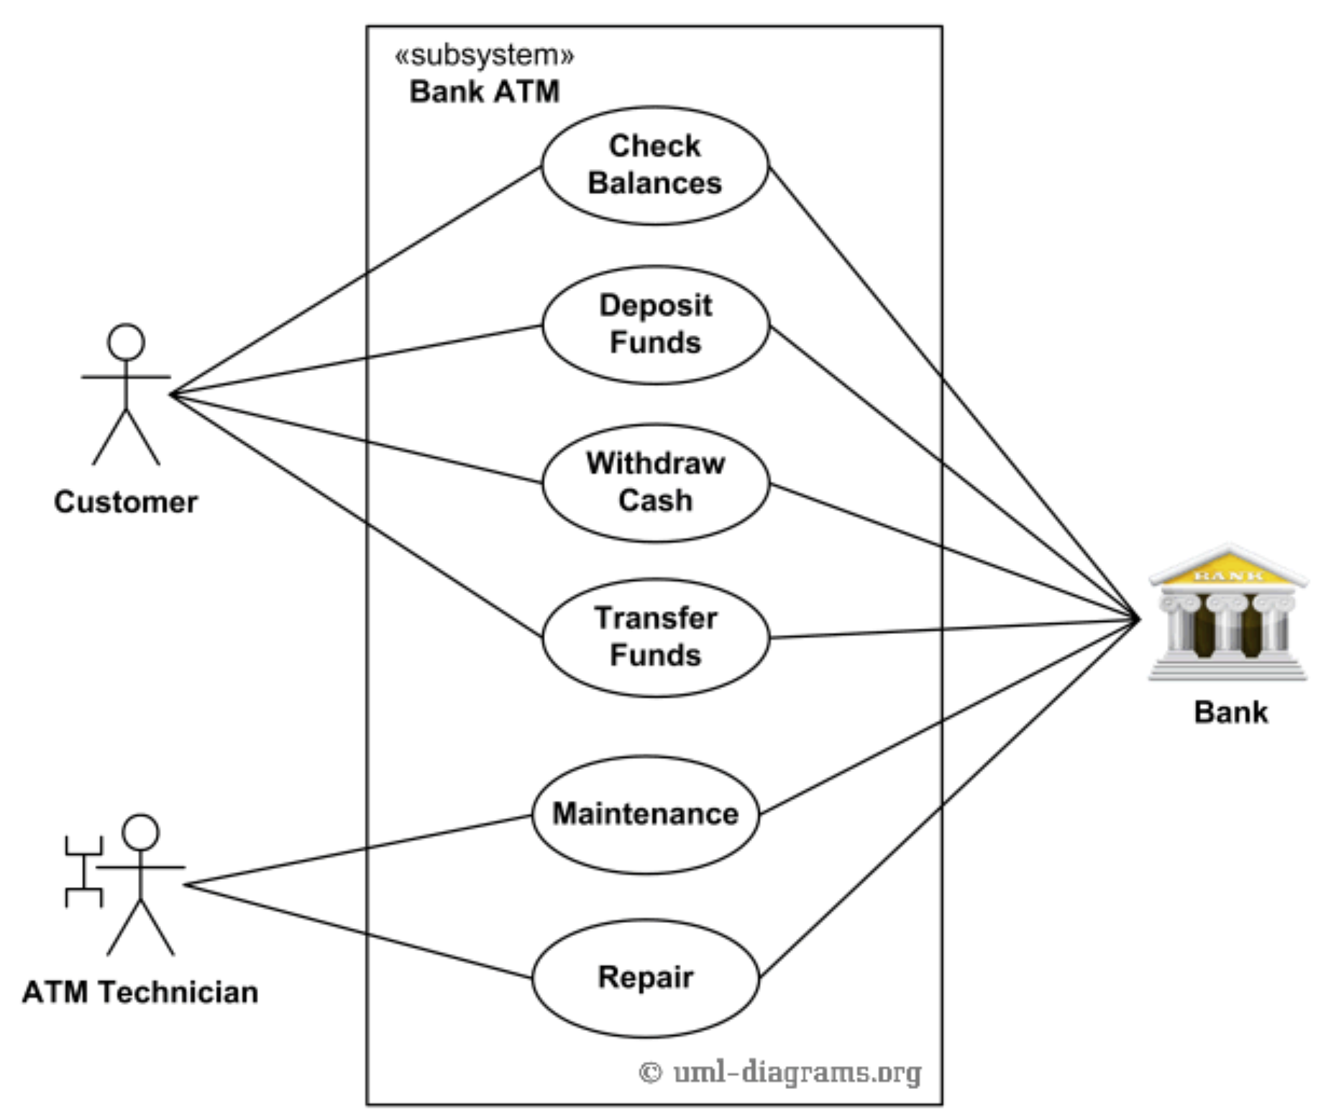
Use Cases (cont.)
An example of use case diagram for Bank ATM subsystem - top level use cases
Developing Use Cases
Context
Outside entities
System behaviors
Identifying the Actors
Principal actors
Secondary actors
External hardware
Other Systems
Identifying the Flow
The beginning of the use case
The origin of information
The exchange of information
The end of the use case
Credits to uml-diagrams.org

Slide 17
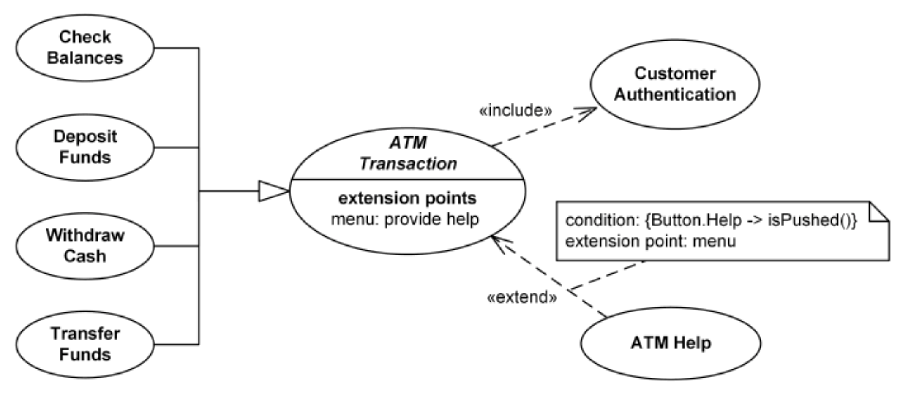
Use Cases (cont.)
Bank ATM Transactions and Customer Authentication Use Cases

Slide 18
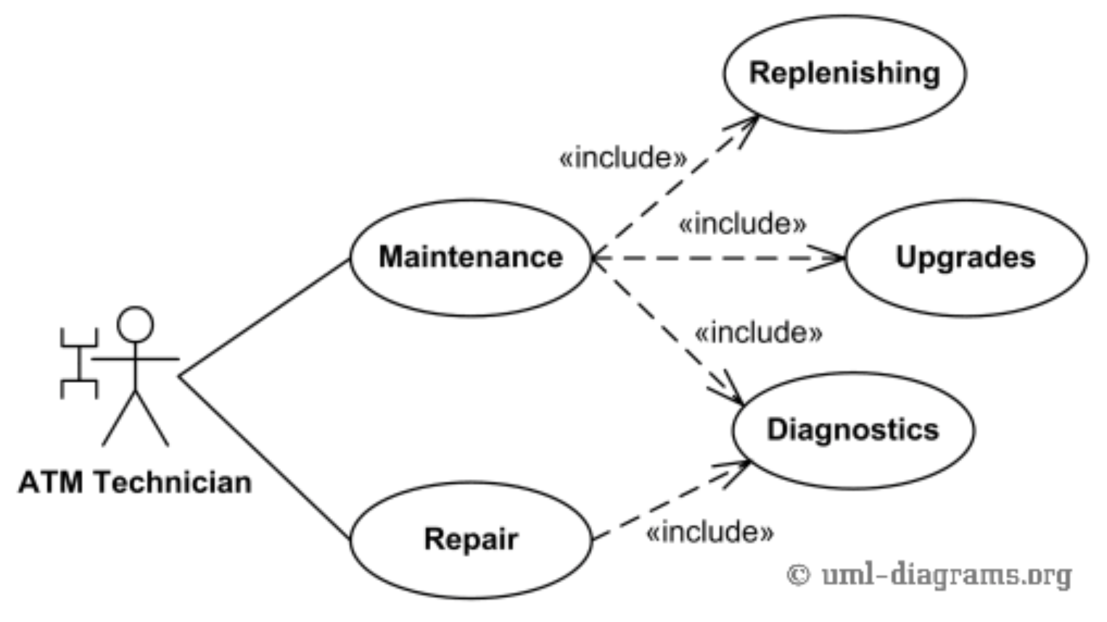
Use Cases (cont.)
Bank ATM Maintenance, Repair, Diagnostics Use Cases
Credits to uml-diagrams.org
https://www.uml-diagrams.org/bank-atm-uml-use-case-diagram-example.html?context=uc-examples

Slide 19
Stating Specifications in Agile Processes
A user story is a description of a function a product must provide for a user.
User stories can be expressed at many levels of abstraction.
Epics
Features
Sprintable (implementable) stories

Slide 20
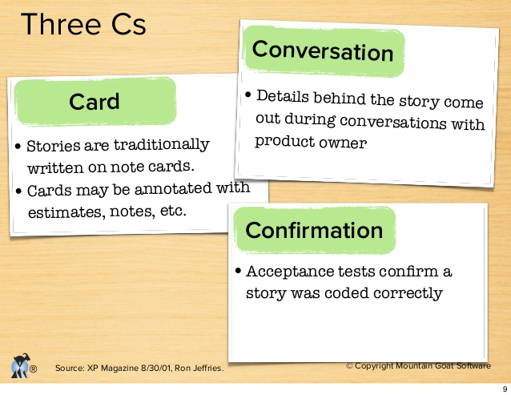
Stating Specifications in Agile Processes (cont.)
User stories are usually expressed in user voice form.
As a <role>, I want to <activity> so that <benefit>.
E.g. - As a bank teller, I want to see account balances so that I can answer customer inquiries.
User stories, in particular sprintable user stories, also have acceptance criteria or conditions of satisfaction.
Three Cs of user stories:
Card
Conversation
Confirmation

Slide 21
Eliciting Stakeholder Needs in Traditional Processes
Common techniques:
Interviews
Observation
Focus groups
Workshops
Prototypes
Document studies
Competitive product studies

Slide 22
Eliciting Stakeholder Needs in Agile Processes
Needs are elicited continuously during development.
Pros:
Stakeholders can express needs that have only just arisen in response to the current situation
Stakeholders can see the current state of the product and react to it in formulating needs
Cons:
Stakeholders may over-react to recent events, losing track of the big picture.
Agile methods usually place great trust in a few (not all) stakeholders or stakeholder representatives.

Slide 23
Verifying and Validating Requirements in Traditional Processes
Five important characteristics:
Clarity
Consistency
Completeness
Correctness
Well-formedness
Main technique - reviews

Slide 24
Verifying and Validating Requirements in Agile Processes
The most careful check of requirements is during the reviews at the conclusion of each sprint.
Major threat to this approach
Usually, not all stakeholders can attend every sprint review.

Slide 25
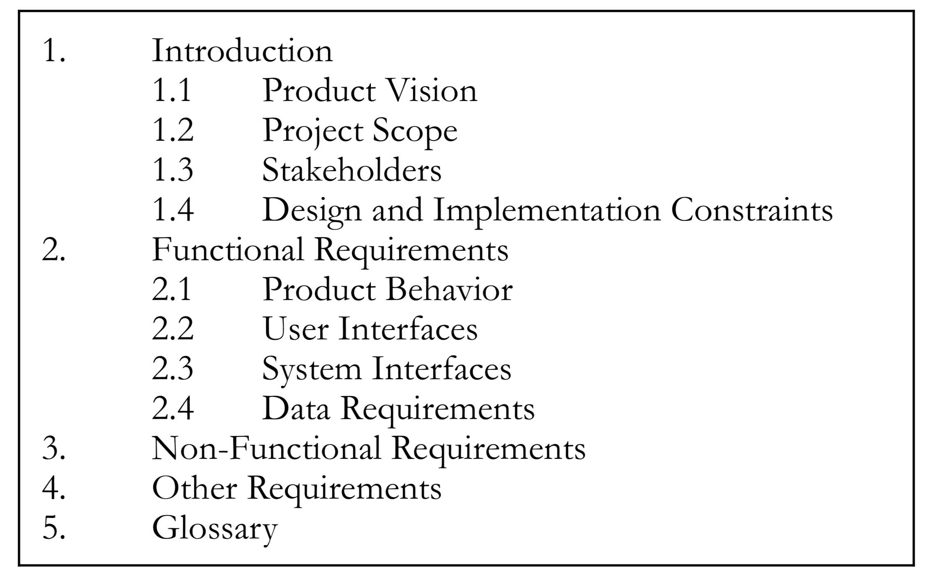
Requirements Management in Traditional Processes
A project is launched with a product mission statement.
Then One or more requirements specialists then conduct an extensive requirements analysis.
Requirements analysis is the activity of eliciting, examining, and understanding stakeholder needs, developing requirements specifications, and evaluating them to ensure that they are clear, complete, consistent, correct, and well formed.
The output is a software requirements specification (SRS)

Slide 26
Requirements Management in Agile Processes
Agile projects begin with some project mission statement in the form of epics or feature.
The product owner refines these high-level features into user stories.
During each sprint, user stories are refined into physical-level requirements and then implemented.
At the conclusion of each sprint, stakeholders and the product owner validate requirements during sprint review.
Requirements management is a core activity of agile methods, but it is incorporated into the broader processes of backlog grooming and sprinting, and not distinguished as a separate process.

Slide 27
Requirements vs. Product Design
Are they the same thing?

